Slide 1
Digital Portfolio
Creating your digital presence

Slide 2
Differences
Social Media
Fun
Portfolio
Opportunities
Impress
Friends
Network
Likes
Audience
Objective
Results

Slide 3
Platforms
Wix
Weebly
Google
Linkedin
Professional

Slide 4
Examples
http://1100204818.wixsite.com/career-profile
http://2000082786.wixsite.com/sblackportfolio
https://1100334739.wixsite.com/sjpick
A work
B/C work
B work

Slide 5
Digital Portfolios
10% of Grade
Work in Progress
Multi-Year
Use online tutorials
Required Format
Open Theme, Colors, Etc.

Slide 6
Digital Portfolio
Creation
Go to www.wix.com

Slide 7
Digital Portfolio
Creation
www.wix.com

Slide 8
Digital Portfolio
fcsgaonline.org
Creation
www.wix.com
Your real Email
Write it down!

Slide 9
Digital Portfolio
Creation
www.wix.com
Customize Later

Slide 10
Digital Portfolio
Creation
www.wix.com

Slide 11
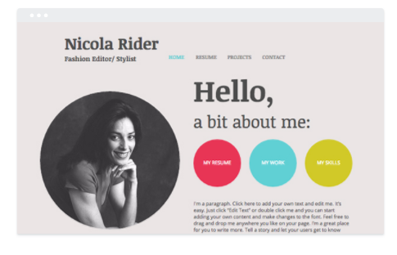
Digital Portfolio
DON’T CLICK YET!
Creation
www.wix.com
Must have TOP menu! Room for 6 Menu choices

Slide 12
ON Prompt
Have headphone or earbuds ready
Click to edit
Youtube video will start
DO NOT DO ANYTHING AFTER VIDEO

Slide 13
Home
Career
Education
Resume
Portfolio
YOUR OPTION (can add later).
Change Page Name

Slide 14
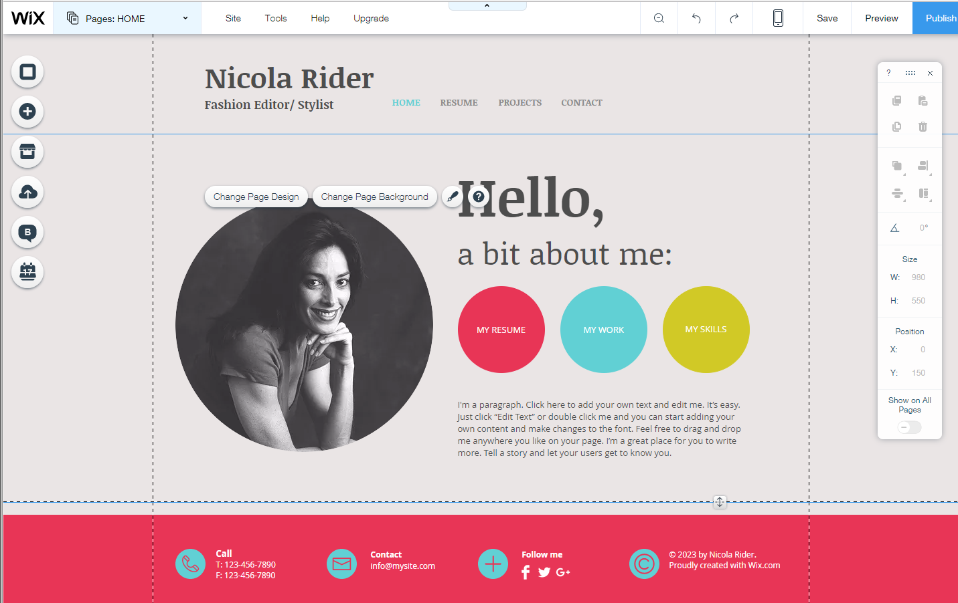
Change Page Name

Slide 15
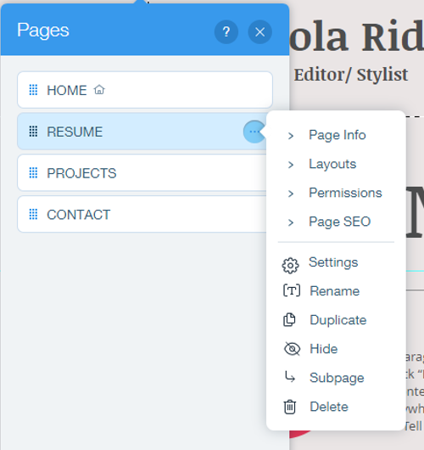
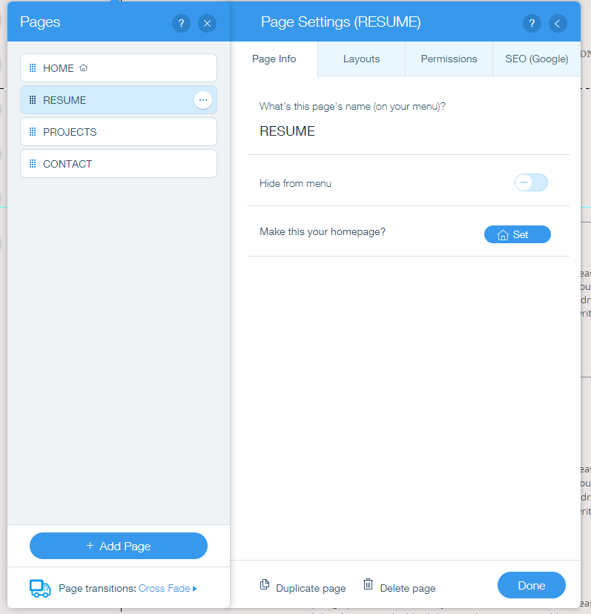
Change Page Name

Slide 16
Home
Career
Education
Resume
Portfolio
Director Project
Add Page

Slide 17
Add Page

Slide 18
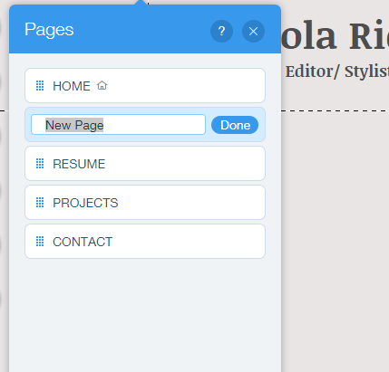
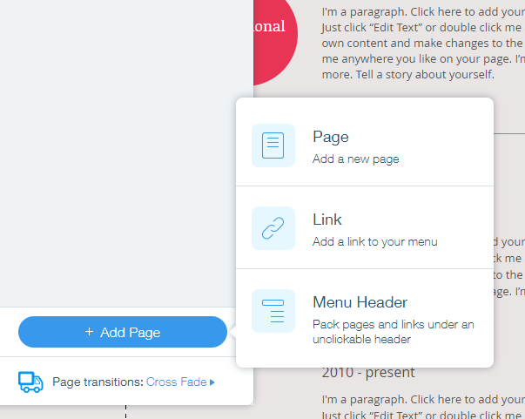
Add Page

Slide 19
Menu Order

Slide 20
Next
Publish

Slide 21
Write Down
Publish
Next

Slide 22
FIX
FIX
We will format next
FIX

Slide 23
HOME PAGE Instructions
Develop a Home Page that is dynamic and will captivate visitors into wanting to learn more about you. Include the following information on your Home Page:
Include a Heading that lists the title “All About Me” or something close to that.
Include 6 sections on your page– use complete sentences in each section.
Your headings should be the second largest text on the page
Use heading tags
Introduction – Bold each heading. Write a paragraph about yourself mention short and long term goals related to academic and personal goals
1. Include at least 5 facts about you
2. These things can include hobbies, travel experiences, academic, etc.
Family History - Include at least 5 interesting facts about your family.
Resume – Leave open for now
College – Leave open for now
Career – Leave open for now
Portfolio – Leave open for now

